Slide 1
INTERNSHIP
Final PRESENTATION
Presented by
Md Masum Billah

Slide 2


About the Company
B-Trac Solutions Ltd. is a prominent ICT (Information & Communications Technology) company based in Dhaka, Bangladesh. It specializes in digital services, IoT solutions, and software development for web, mobile, desktop, and embedded systems.
They operate under the Bangla Trac Group.
https://www.btracsolutions.com

Slide 3
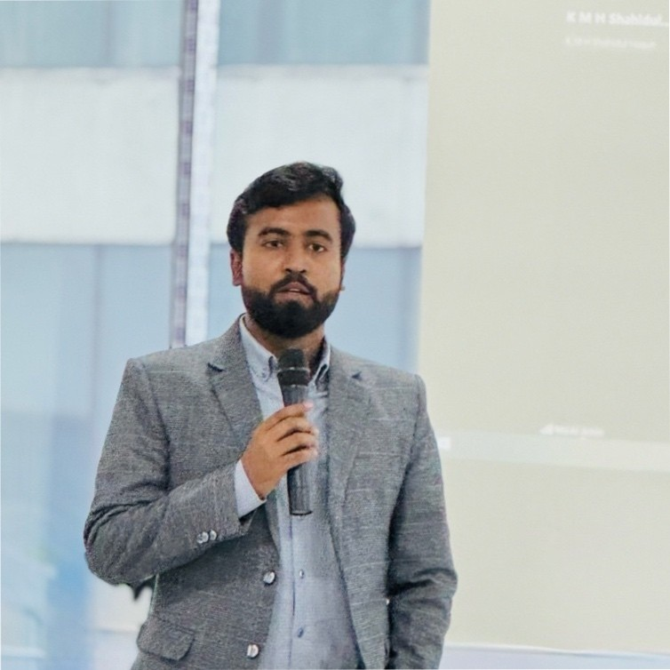
Internship Supervisor
Md. Mazba Kamal
Deputy Manager
B Trac Solutions
mazba.kamal@btracsl.com

Slide 4
1. Finding accommodation
2. Transportation: The roads were too polluted.
3. Fitting into company culture: Understanding the norms, working style, and expectations.
4. Proving your skills: Interns are sometimes assumed to only have basic skills, so I had to demonstrate more advanced skills.
Initial Challenges
9

Slide 5
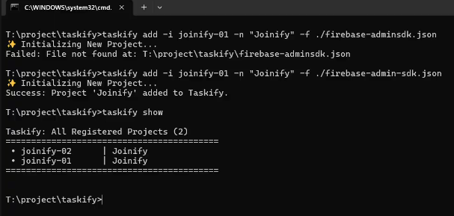
Practice Project
Taskify
A command-line tool for managing Firebase projects locally

Slide 6
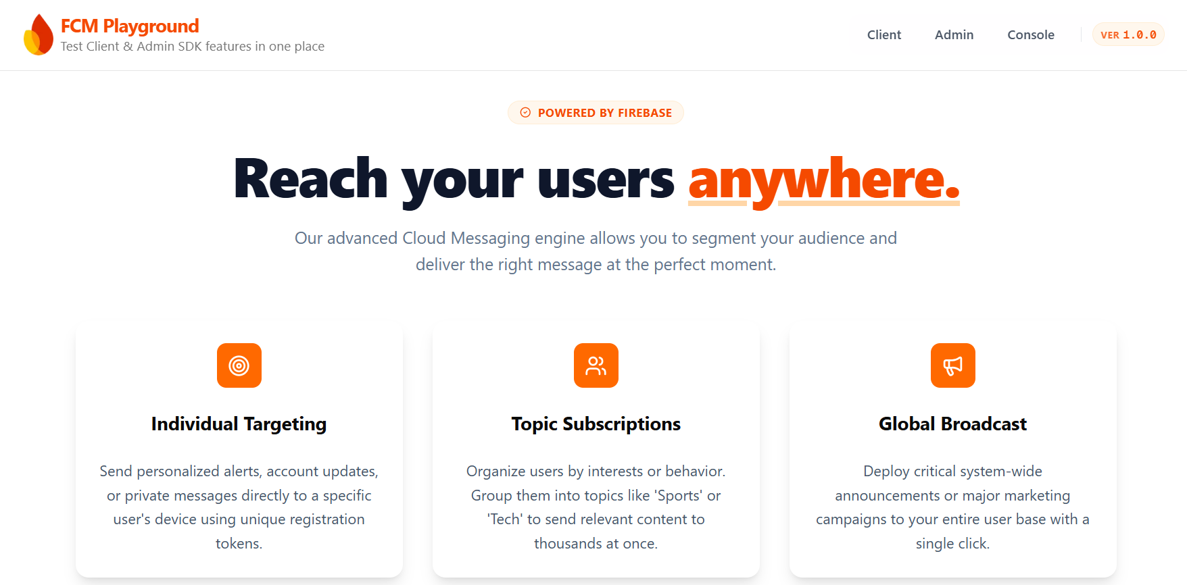
Practice Project
FCM Playground
A sandbox for implementing Firebase Cloud Messaging

Slide 7
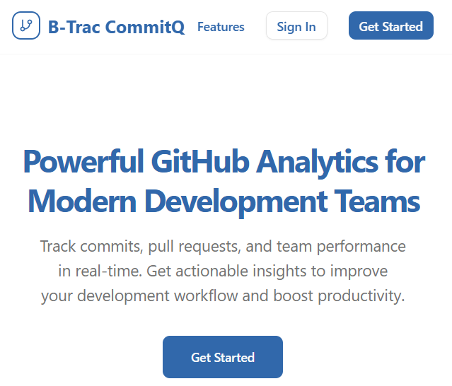
Assigned Project
B-Trac
CommitQ
GitHub analytics system for tracking internal team performance

Slide 8
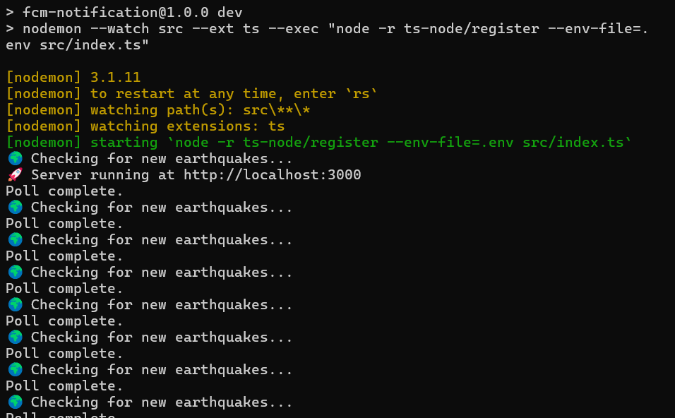
Assigned Project
BTSL Disaster Notification
Real-time earthquake alert system for all the application within the organization

Slide 9




New Skills Learned
TypeScript
Improved code quality with strong typing and error prevention.
Next.js
Built fast, scalable, and SEO-friendly web applications.
GraphQL API
Learned to structure and query data efficiently using GitHub’s GraphQL API.
GitHub GraphQL API
Implemented authenticated queries and pagination to interact with GitHub repositories and user data.

Slide 10




New Skills Learned
Firebase Cloud Message
Send push notifications for real-time updates and improved user engagement.
Command Line Tool
Learned to build and publish CLI tools on npm using Commander.js
Design Principles
Learned how to design scalable, maintainable APIs with clear structure, versioning, and best practices.
Deployment
Hands-on experience with server environments, command-line operations, and VPS management.

Slide 11
1. Gained exposure to real-world industry practices and professional development workflows.
2. Due to separate seating arrangements, collaboration with teammates was limited compared to what could have been achieved in a more shared environment.
3. Maintained a super friendly, positive, and helpful attitude, contributing to a supportive work atmosphere.
Self Judgement

Slide 12
Thank You!
For your listening...

